Slide 1
Sanjivani University
School of Engineering and Technology Department of Computer Science and Engineering (AIML)
Application Development Practices
(24UMLES101)
Unit -1
Software Development Model
By,
Mr. Yogesh Sopan Modhe

Slide 2
Contents
Introduction to software development process
Software Engineering Principles
Requirement Gathering and Analysis
Traditional Software Development Models
Overview of Programming Languages
Agile Software Development
Agile Methodology (Scrum, Kanban)
DevOps practices,
Comparison of Methodologies
Case study

Slide 3
Software ?
What is Software ? - Software is a set of instructions, data or programs used to operate computers and execute specific tasks. It is the opposite of hardware, which describes the physical aspects of a computer. Software is a generic term used to refer to applications, scripts and programs that run on a device.
Software is defined as a collection of programs, documentation and operating procedures. The Institute of Electrical and Electronic Engineers (IEEE) defines software as a 'collection of computer programs, procedures, rules and associated documentation and data.
Why it is essential ? –
For Automation
Data Management and Analysis
Improve User Experience
Innovation and Problem Solving
Global Connectivity
Enhanced Communication etc.

Slide 4
Software Development Process
Process – It's essential as it's productive, time-saving, and helps us in fast delivery and development with more accuracy.
A generic process framework for software engineering encompasses five activities:
Communication
Planning
Modeling
Construction
Deployment
The essence of practice –
Understand the problem (communication and analysis)
Plan a solution (modeling and software design)
Carry out the plan (code generation)
Examine the result for accuracy (testing and quality assurance).

Slide 5
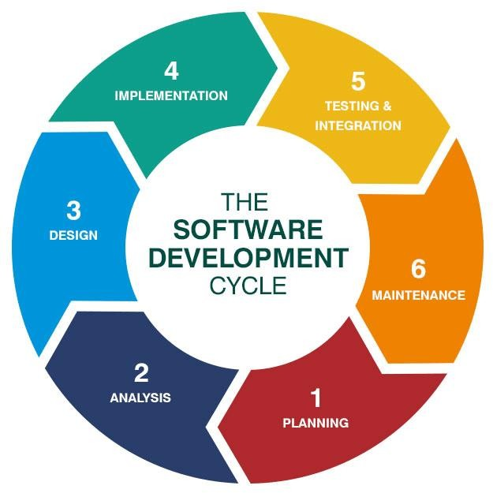
Software Development Process
Fig 1. Software Development Process

Slide 6
Software Engineering Principles
The Reason it all exists
Keep It Simple
Maintain the Vision
What You Produce, Others Will Consume
Be Open to the Future
Plan Ahead for Reuse
Think

Slide 7
Requirement Gathering and Analysis
In software development, the requirements gathering and analysis process is typically led by a dedicated team, usually consisting of business analysts, project managers, and occasionally lead developers. Their role is to systematically uncover and define the needs and conditions for the software project, ensuring alignment with business goals and user requirements.
This development team engages with various stakeholders, which may include customers, end users, and internal team members, to gain comprehensive insight into what the software must do. They use methods such as interviews, surveys, workshops, and document analysis to gather detailed information about user needs, business processes, business process documentation, and system requirements.
At this stage, they may decide to develop a proof of concept project to test the feasibility of the initial assumptions – a key step in developing non-standard software solutions.
This team plays a critical role in bridging the gap between the technical and business aspects of software development.

Slide 8
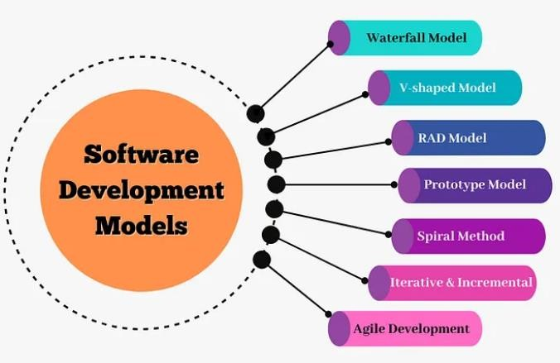
Software Development Process Models
Fig. 2 Various software development models

Slide 9
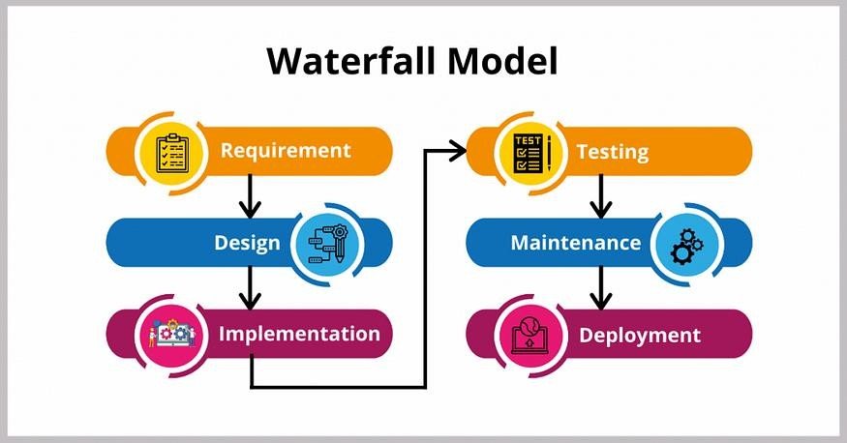
Waterfall Model
Fig. 3 Waterfall Model

Slide 10
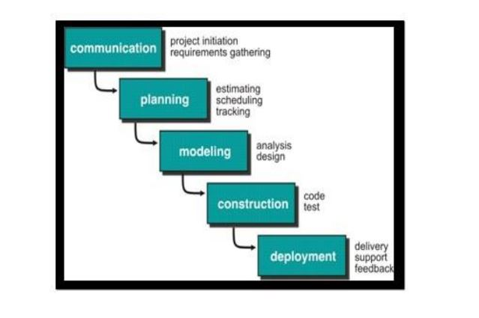
Waterfall Model
Fig. 3.1 Waterfall Model

Slide 11
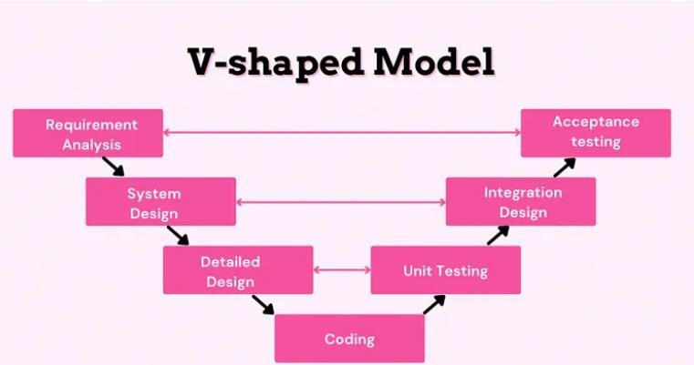
V-Shaped Model
Fig. 4 V-Shaped Model

Slide 12
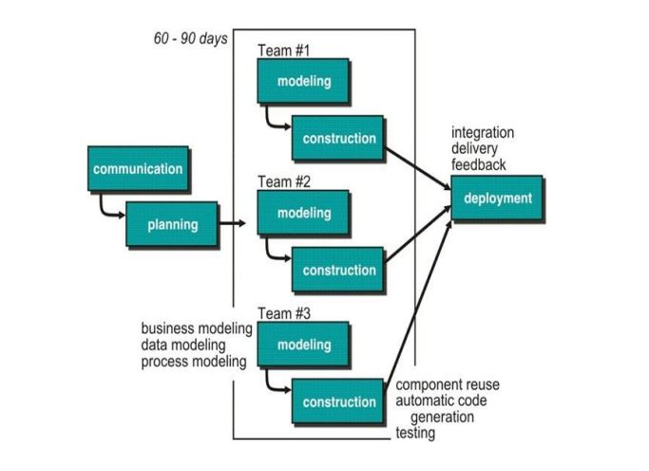
Rapid Application Development (RAD) Model
Fig. 5 RAD Model

Slide 13
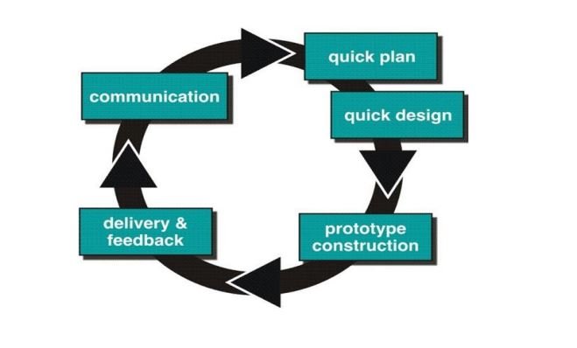
Prototype Model
Situation in which prototyping model is applicable: Often, a customer defines a set of general objectives for software, but does not identify detailed requirements for functions and features. In other cases, the developer may be unsure of the efficiency of an algorithm, the adaptability of an operating system, or the form that human-machine interaction should take. In these, and many other situations, a prototyping paradigm may offer the best approach.

Slide 14
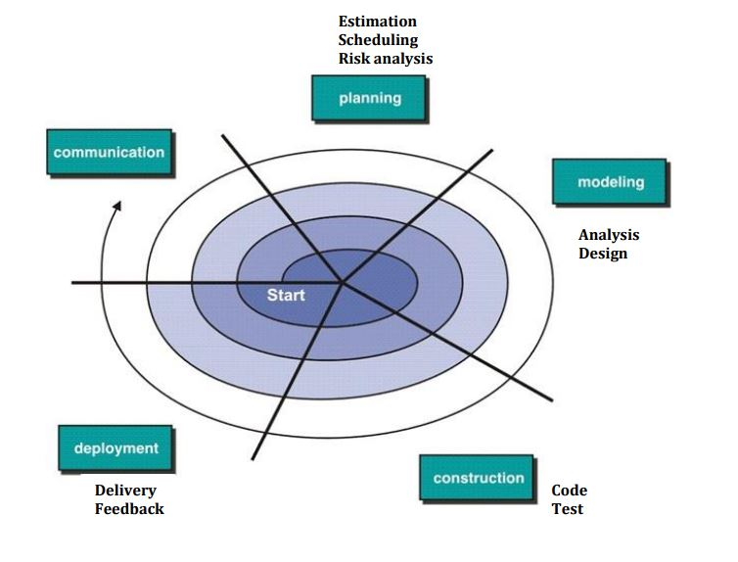
Spiral Model
Fig. 6 Spiral Model

Slide 15
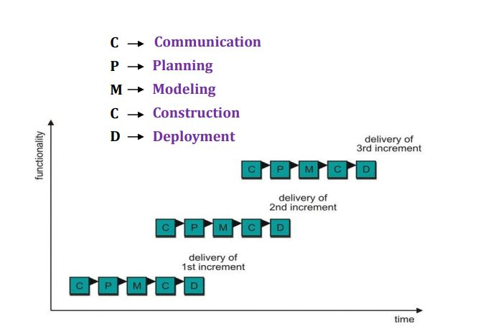
Iterative and Incremental Model
The incremental model allows stakeholders and developers to check results using the first increment. The developer only focuses on a clear and complete definition of the whole system before you start. The Model is great for a project with loosely coupled parts and projects with exact, precise needs.

Slide 16
Overview of Programming Languages
A programming language is a set of instructions and syntax used to create software programs. Some of the key features of programming languages include:
Syntax: The specific rules and structure used to write code in a programming language.
Data Types: The type of values that can be stored in a program, such as numbers, strings, and booleans.
Variables: Named memory locations that can store values.
Operators: Symbols used to perform operations on values, such as addition, subtraction, and comparison.
Control Structures: Statements used to control the flow of a program, such as if-else statements, loops, and function calls.
Libraries and Frameworks: Collections of pre-written code that can be used to perform
common tasks and speed up development.
Paradigms: The programming style or philosophy used in the language, such as procedural, object-oriented, or functional.

Slide 17
Agile Software Development
What is Agile ?- The Agile methodology is a project management approach that involves breaking the project into phases and emphasizes continuous collaboration and improvement. Teams follow a cycle of planning, executing, and evaluating.
https://www.youtube.com/watch?v=8eVXTyIZ1Hs
Agility Principles
Priority is to satisfy the customer through early and continuous delivery of valuable software | Welcome changing requirements, even late in development. Agile processes harness change for the customer’s competitive advantage.
Deliver working software frequently, from a couple of weeks to a couple of months, with a preference to the shorter timescale. | Business people and developers must work together daily throughout the project.
Build projects around motivated individuals. Give them the environment and support they need, and trust them to get the job done. | The most efficient and effective method of conveying information to and within a development team is face-to-face conversation.
Working software is the primary measure of progress. | Agile processes Promote sustainable development
Continuous attention to technical excellence and good design enhances agility. | Simplicity—the art of maximizing the amount of work not done—is essential.
The best architectures, requirements, and designs emerge from self– organizing teams. | At regular intervals, the team reflects on how to become more effective, then tunes and adjusts its behavior accordingly.

Slide 18
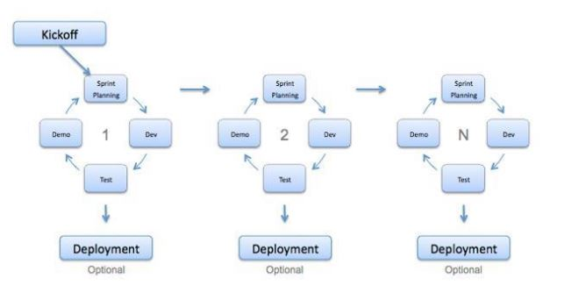
Agile Software Development
Agile Software Development sample case study with - https://asana.com/templates/agile-project-plan

Slide 19
Agile Software Development
Advantages of Agile model:
Customer satisfaction by rapid, continuous delivery of useful software.
People and interactions are emphasized rather than process and tools. Customers, developers and testers constantly interact with each other.
Working software is delivered frequently (weeks rather than months).
Face-to-face conversation is the best form of communication.
Close, daily cooperation between business people and developers.
Continuous attention to technical excellence and good design.
Regular adaptation to changing circumstances.
Even late changes in requirements are welcomed

Slide 20
Agile Software Development
Disadvantages of Agile model:
In case of some software deliverables, especially the large ones, it is difficult to assess the effort required at the beginning of the software development life cycle.
There is lack of emphasis on necessary designing and documentation.
The project can easily get taken off track if the customer representative is not clear what final outcome that they want

Slide 21
Scrum
Scrum is a management framework that teams use to self-organize and work towards a common goal. It describes a set of meetings, tools, and roles for efficient project delivery.
Scrum Principles
Transparency
Reflection
Adaption
Scrum values for Project team-
Commitment
Courage
Focus
Openness
Respect
Source- https://aws.amazon.com/what-is/scrum/

Slide 22
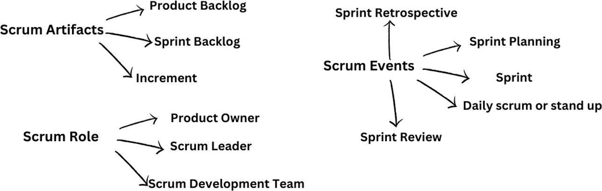
Working of Scrum
How does it work ? - Scrum is a framework that is easy to learn but difficult to become an expert in. The essence of Scrum is a self-organizing team delivering customer value in a time-boxed period called a Sprint. Scrum defines artifacts, roles, and events associated with each Sprint.
Source- https://aws.amazon.com/what-is/scrum/

Slide 23
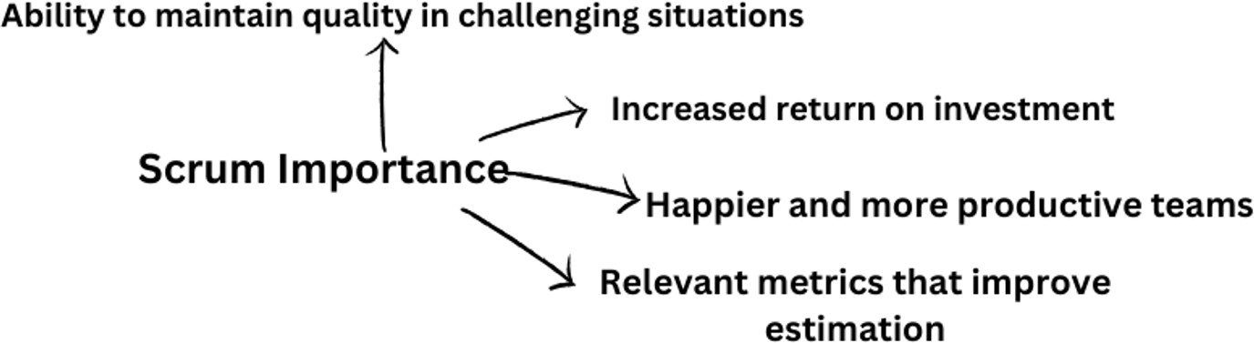
Importance of Scrum in S/W Development
Source- https://aws.amazon.com/what-is/scrum/

Slide 24
Scrum vs. Agile
Agile refers to a mindset or way of thinking in software development.
It is a philosophy adopted at an organizational level to get every team member to focus on continuous improvement and value delivery to customers.
Scrum is a framework for getting work done within agile.
Scrum uses all the core principles of agile to define methods to facilitate a project.
However, it is important to note that agile does not always mean Scrum.
Source- https://aws.amazon.com/what-is/scrum/

Slide 25
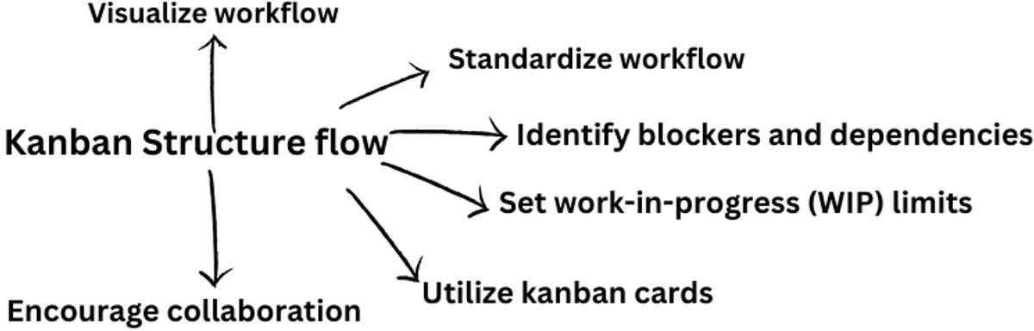
Kanban
Kanban is a popular framework used to implement Agile and DevOps software development. It requires real-time communication of capacity and full transparency of work. Work items are represented visually on a kanban board, allowing team members to see the state of every piece of work at any time.
Source- https://www.atlassian.com/agile/kanban

Slide 26
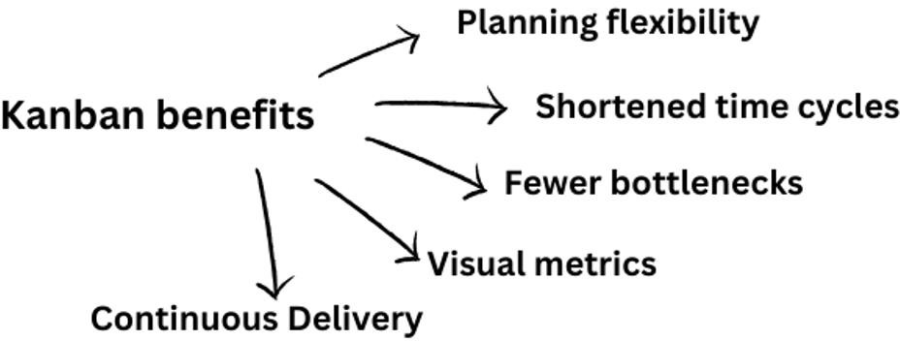
Benefits of Kanban
Source- https://www.atlassian.com/agile/kanban

Slide 27
Scrum vs. Kanban
 | SCRUM | KANBAN
Release methodology | Regular fixed-length sprints (i.e., two weeks) | Continuous flow
Roles | Product owner, scrum master, development team | Continuous delivery or at the team's discretion
Key metrics | Velocity | Cycle time
Change philosophy | Teams should strive not to change the sprint forecast during the sprint. Doing so compromises learning around estimation. | Change can happen at any time

Slide 28
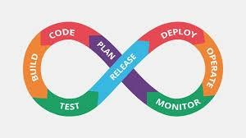
DevOps
DevOps is the combination of cultural philosophies, practices, and tools that increases an organization’s ability to deliver applications and services at high velocity: evolving and improving products at a faster pace than organizations using traditional software development and infrastructure management processes. This speed enables organizations to better serve their customers and compete more effectively in the market.
Fig. 7 DevOps Process

Slide 29
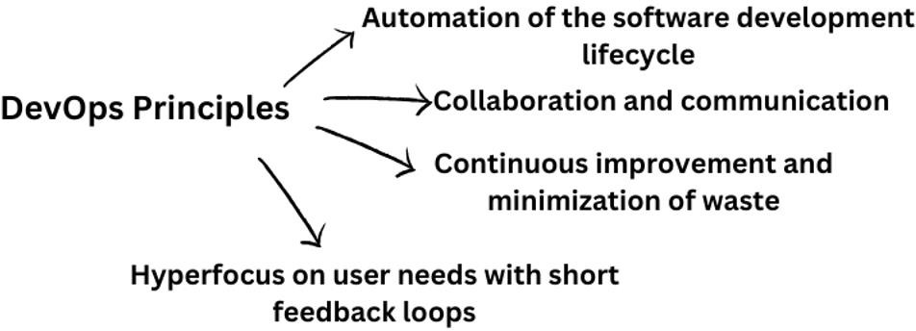
Core DevOps Principles
Source- https://about.gitlab.com/topics/devops/

Slide 30
Core DevOps Principles

Slide 31
DevOps Phases
Phase 1: Bring Your Own DevOps (BYOD)
Phase 2: Best-in-class DevOps
Phase 3: Do-it-yourself (DIY) DevOps
Phase 4: DevOps Platform

Slide 32
DevOps tools, concepts and fundamentals
Topic | Description
Version control | The fundamental practice of tracking and managing every change made to source code and other files. Version control is closely related to source code management.
Agile | Agile development means taking iterative, incremental, and lean approaches to streamline and accelerate the delivery of projects.
Continuous Integration (CI) | The practice of regularly integrating all code changes into the main branch, automatically testing each change, and automatically kicking off a build.
Continuous Delivery (CD) | Continuous delivery works in conjunction with continuous integration to automate the infrastructure provisioning and application release process. They are commonly referred to together as CI/CD.
Shift left | A term for shifting security and testing much earlier in the development process. Doing this can help speed up development while simultaneously improving code quality.

Slide 33
Benefits of DevOps
Collaboration - Adopting a DevOps model creates alignment between development and operations teams
Fluid responsiveness - More collaboration leads to real-time feedback and greater efficiency; changes and improvements can be implemented quicker and guesswork is removed
Shorter cycle time - Improved efficiency and frequent communication between teams shortens cycle time; new code can be released more rapidly while maintaining quality and security.

Slide 34
Comparisons
Case study to find the comparison between Agile, Scrum, Kanban and DevOps.

Slide 35
References
Rogers Pressman, “Software Engineering- A Practitioner’s Approach”, 7th Edition, McGraw Hill Edition. Chapter 1-3 from page number 1-65.
Scrum - https://aws.amazon.com/what-is/scrum/
Kanban - https://www.atlassian.com/agile/kanban
DevOps- https://about.gitlab.com/topics/devops/

